Slide 1
Technical Support (420-1N6-AB) Hardware – Clusters
Fall 2022

Slide 2
Clusters
Clusters are a combination of multiple computers or servers with the purpose of giving users access to large amounts of CPU and GPU.
They are often composed of sets of computers or super computers (called nodes).
Each node will perform the same task and will be controlled and managed by a software called a scheduler.

Slide 3
Clusters – components
Computing Nodes: servers that process the user load; they range from simple desktop-class computers to massive high-end servers.
Managing Nodes: a server or multiple servers that manage and monitor the tasks running on the computing nodes.
Private Network(s) - LANS: where the communication between nodes takes place. It is responsible for the ‘are you there?’ messages that the nodes use to verify what servers are up. Also, the command messages need to reconfigure and synchronize the cluster.
Shared storage is where the data is available to all computing nodes.
Public-access layer: will virtualize access to the cluster so the cluster will look like a single system. It can operate by creating virtual IPs that will host the service entry points. It will distribute the incoming requisitions to the currently active hosts

Slide 4
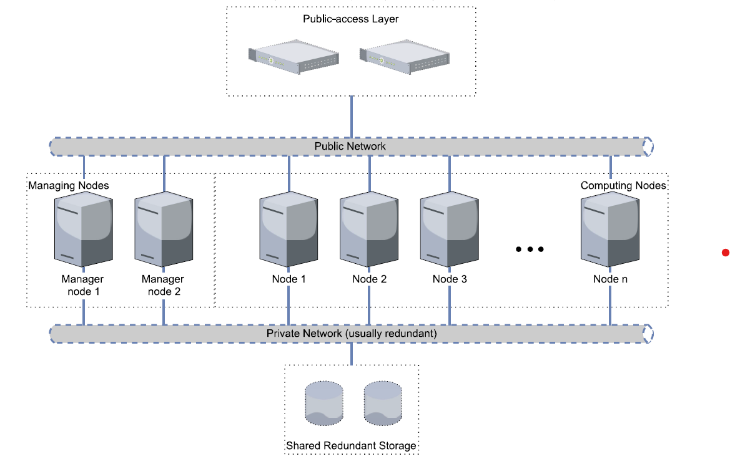
Clusters architecture

Slide 5
Examples of areas where clusters are used…
Big Data: The field of big data requires high amounts of computing power to handle, transform and process these large datasets.
Research: researchers often need more ressources to run cutting edges software and algorithms.
Weather forcasting: Requires heavy processing

Slide 6
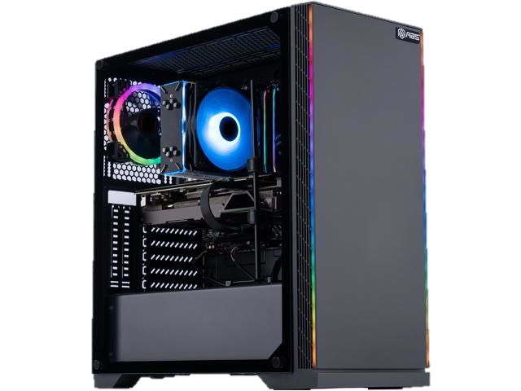
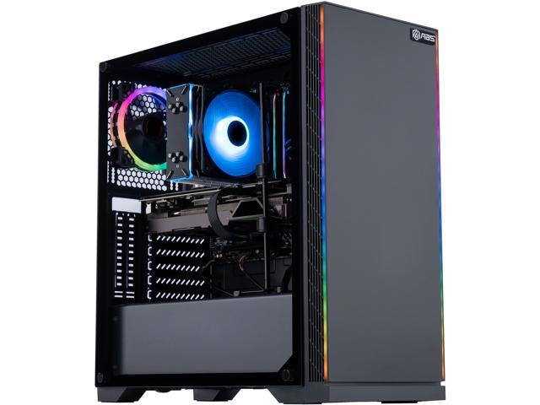
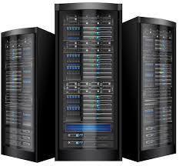
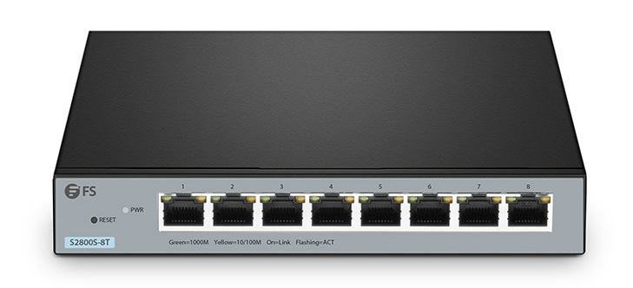
In Assignment 2 : Cerano cluster -­> Question kept as bonus
CentOs Server

Slide 7
Q & A
Notes:
In Slide Show mode, click the arrow to enter the PowerPoint Getting Started Center.

